Slide 1
Plant Monitoring, Monitoring & Notifications and Automatically Water System using AWS IoT
Sekhar Rangam
Engineering Manager

Slide 2
Agenda
Brief Introduction about the talk
About the technical architecture
Basics of Arduino board and its sensors and Arduino AWS SDK to push sensors data to AWS IoT
About AWS IoT and its internals/configurations
Amazon IoT service to log data to AWS - DynamoDB
AWS -SNS notification
About MQQT protocol
Mobile App integration using AWS IoT SDK to enable push notifications
Demo
Best Practices for Running IoT Solutions at Scale on AWS

Slide 3
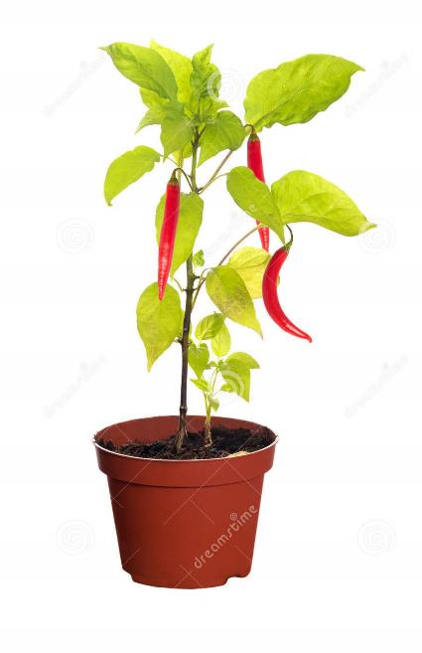
Brief Introduction about the talk
If you are going on a vacation or so and are worried about your house plants at home, don't worry with Plant Monitoring using Mobile App push notifications & Automatically Water System using AWS IoT you can set up your plant to be watered as often as you like and control and monitor from remote location using mobile app connected to AWS IoT

Slide 4
Technical architecture
END to END architecture which covers sending data to IoT gateway, IoT rules to send SNS notifications, storing logs to DynamoDB, Mobile app integration to IoT core with SDK and IoT push notifications to mobile app and its security

Slide 5
Basics of Arduino board and its sensors and Arduino AWS SDK to push sensors data to AWS IoT
Will cover basics of Arduino, its sensors and how Arduino will integrate with IoT core to send the sensors data

Slide 6
About AWS IoT and its internals/configurations
Steps to create AWS IoT things, its security, rules and how to test using endpoints

Slide 7
Amazon IoT service to log data to AWS - DynamoDB
How to integrate with DynamoDB to store the logs data

Slide 8
About MQTT protocol
Will cover basics of MQTT which will help in integrating the client apps

Slide 9
Mobile App integration using AWS IoT SDK to enable push notifications
Will cover the few topics on how mobile app can integrate with AWS IoT using SDK

Slide 10
Demo
Will play a video/ I can also bring the whole setup to show live demo

Slide 11
Best Practices for Running IoT Solutions at Scale on AWS
Few best Practices for Running IoT Solutions at Scale on AWS

Slide 12
Thank you.
Sekhar Rangam
Engineering Manager
sekhar.rangam@bridgei2i.com
M: +91-9916919145
www.bridgei2i.com

